Slide 1
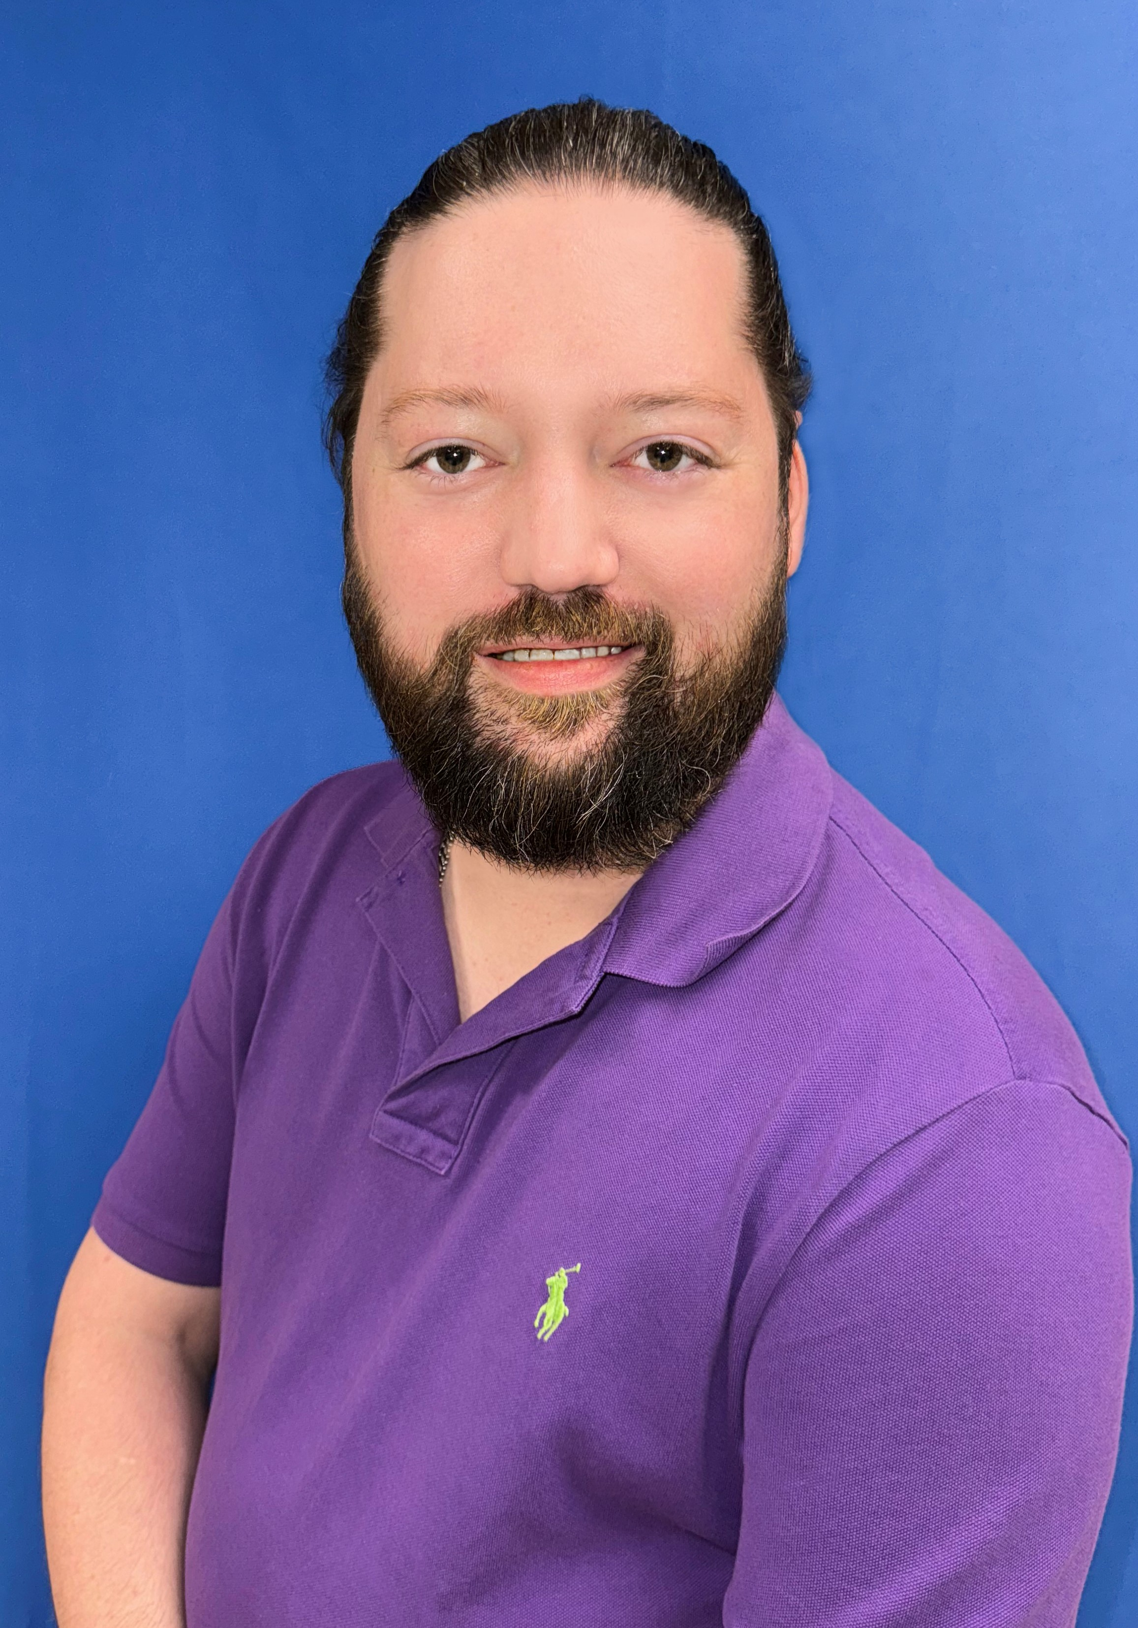
New Member Welcome
Evan Christopher

Slide 2
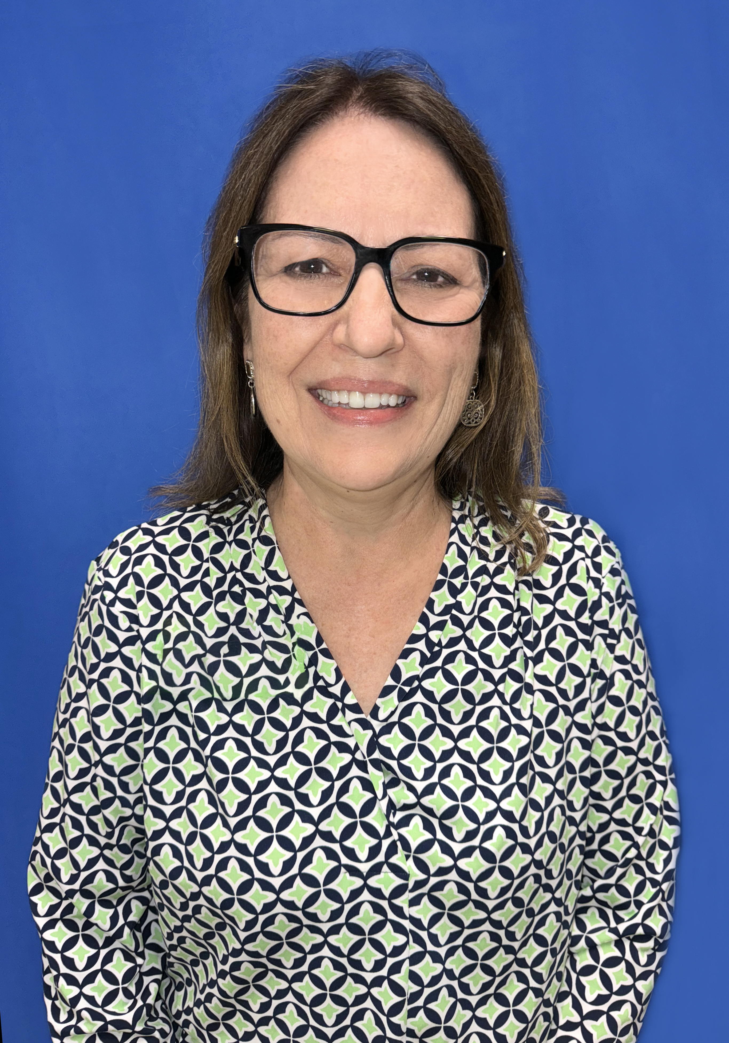
New Member Welcome
Sally Craddock

Slide 3
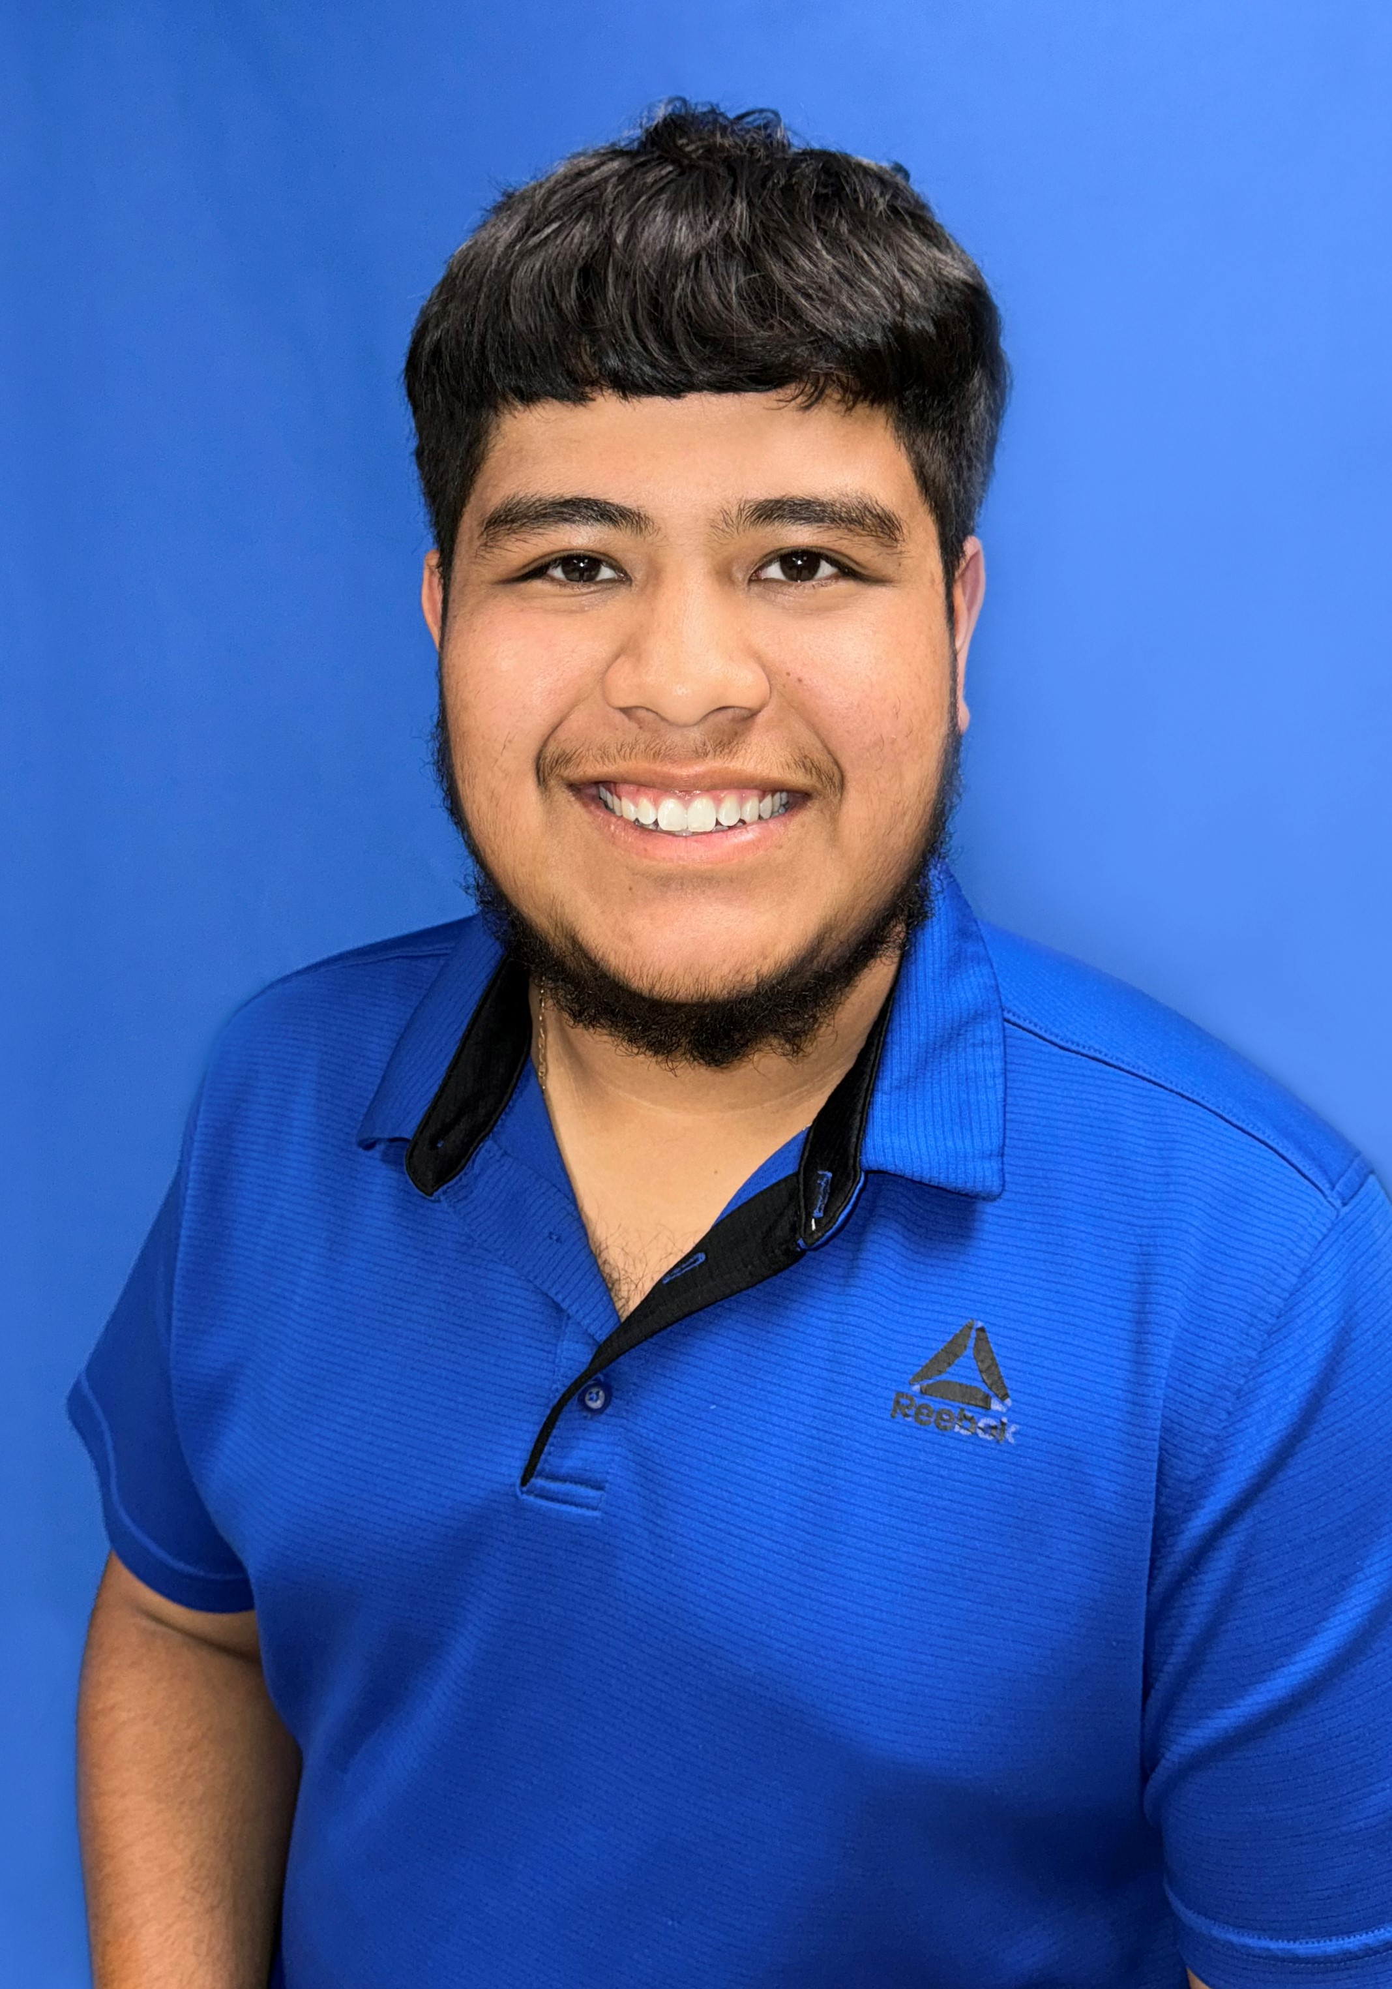
New Member Welcome
Sayne Gonzalez

Slide 4
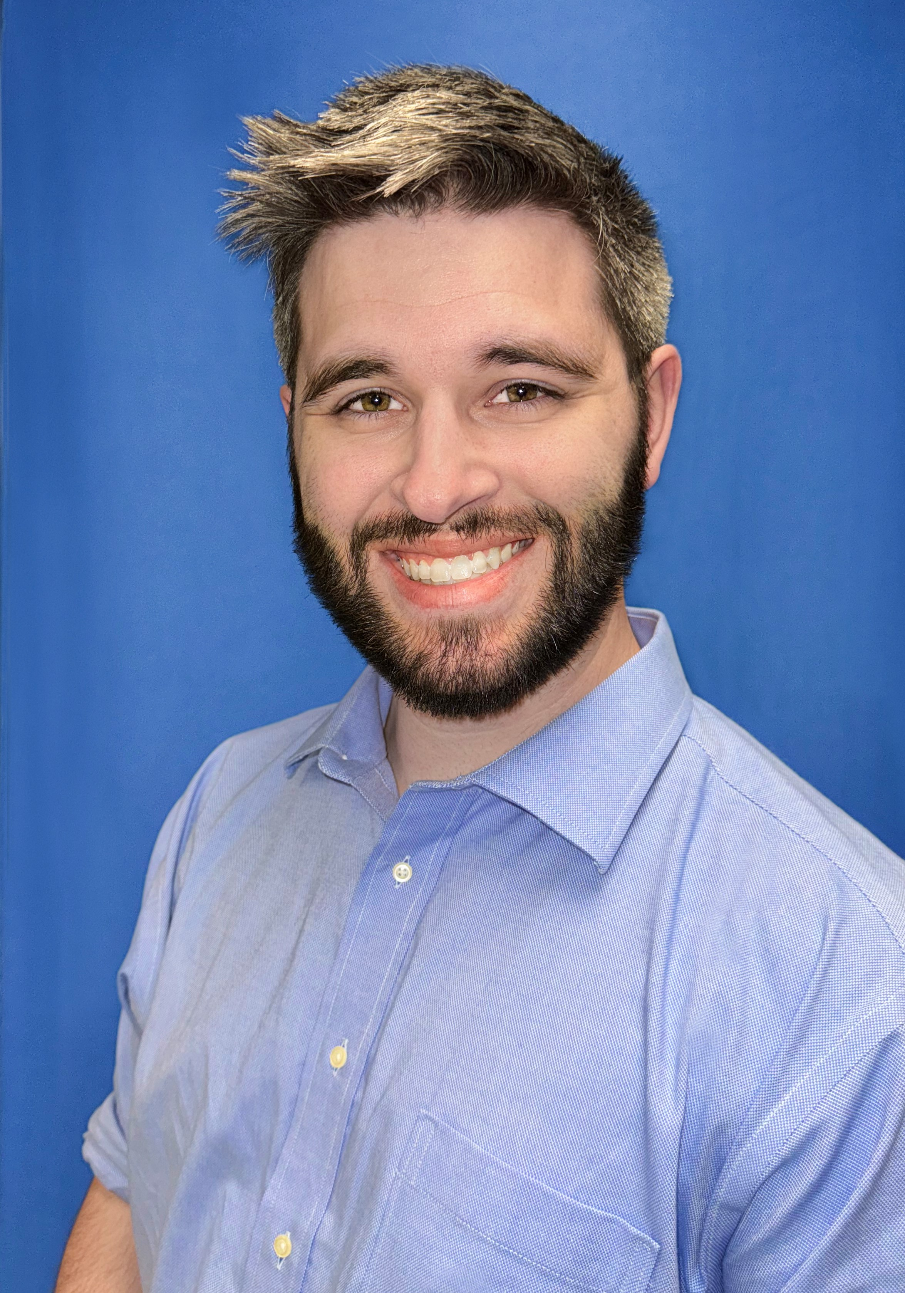
New Member Welcome
Lewis Kasparek

Slide 5
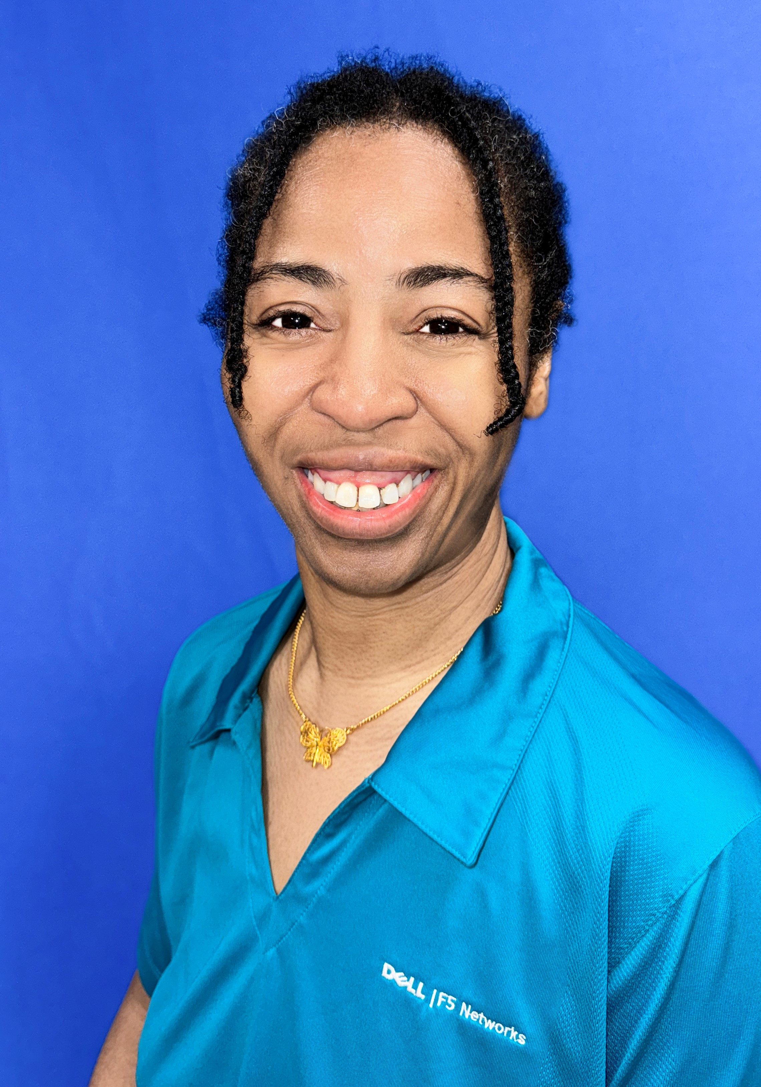
New Member Welcome
Larhonia Peterson

Slide 6
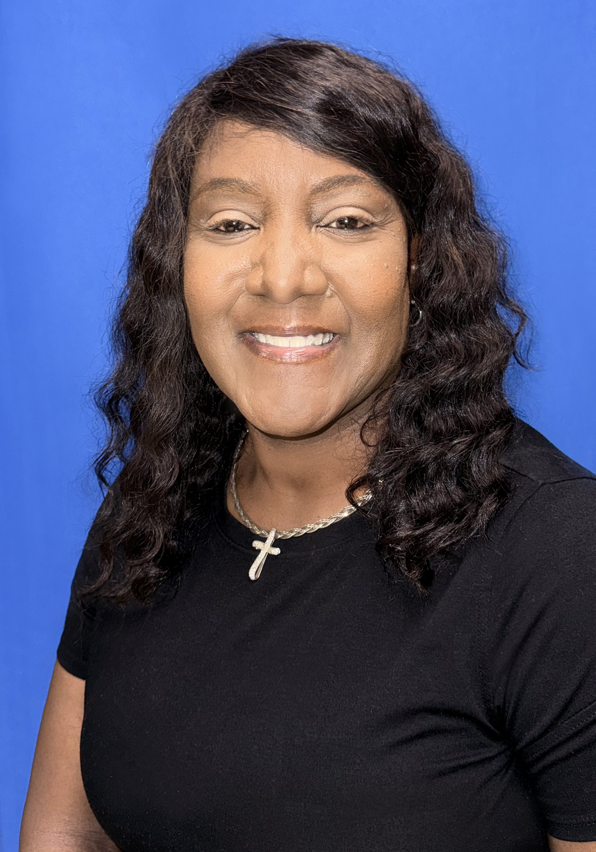
New Member Welcome
Kelly Ward

Slide 7
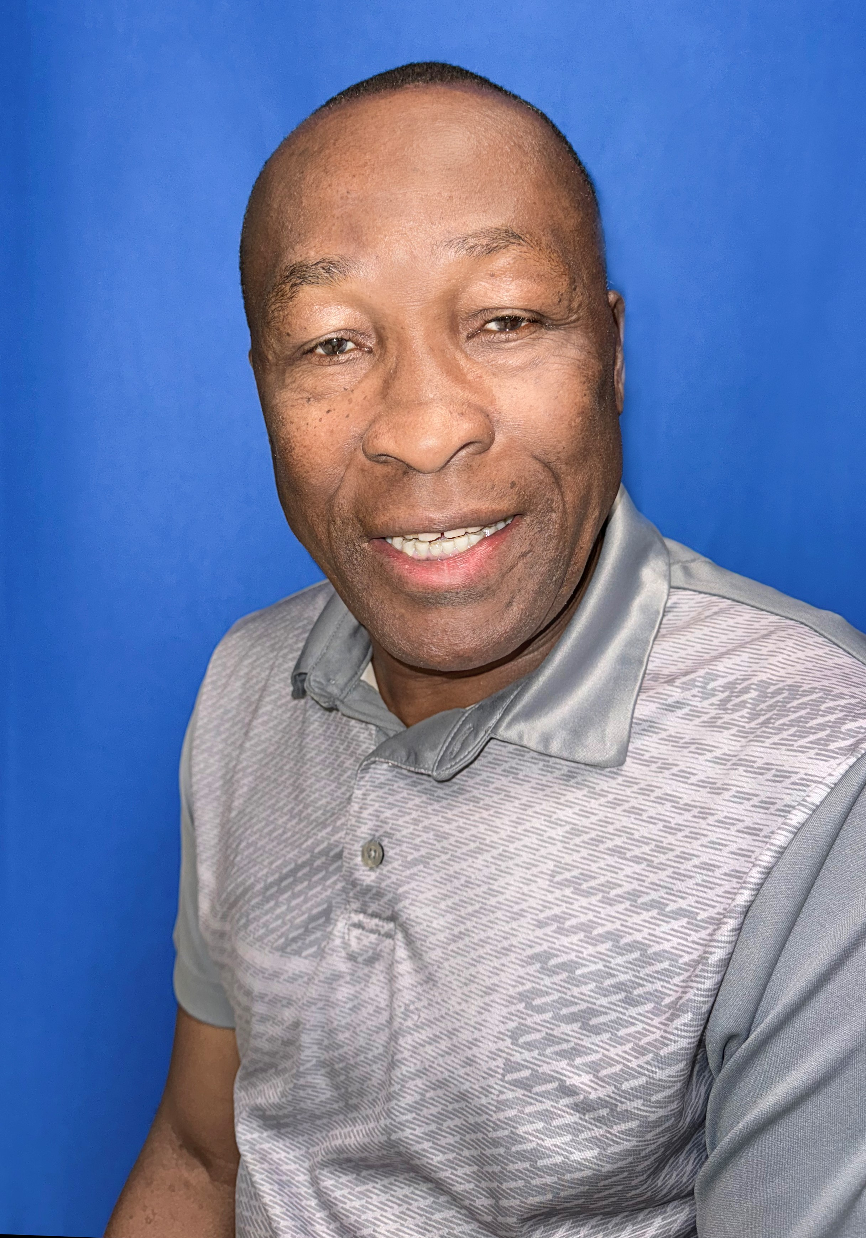
New Member Welcome
Varney Johnson

Slide 8
New Member Welcome
Kelly Spellman

